Slide 1



Introduction
COVID-19 / Epidemic Data Analysis & Forecasting Model
An Excel-based statistical study of cases, deaths, recoveries, and dashboarding

Slide 2



What is COVID-19?
COVID-19 is an infectious disease caused by the SARS-CoV-2 virus, first identified in late 2019. It spreads mainly through respiratory droplets and close contact.
Global Pandemic
Declared by WHO in March 2020
Health System Strain
By 2020 it had become a global pandemic, affecting nearly every country — including India — and placing unprecedented strain on public health systems, economies, and daily life.
Hospitals & healthcare workers overwhelmed
Data-Driven Response
States/UTs tracked cases daily for response planning
Common symptoms
Mild: fever, cough, fatigue, loss of taste/smell
Severe: breathing difficulty, low oxygen, organ stress

Slide 3

Why Analyze COVID-19 Data?
Raw case counts alone don't tell a clear story. Structured analysis turns overwhelming numbers into insights that support public health decisions.
Compare states & UTs
Track progression
Identify most and least affected regions
See how the pandemic evolved over time
Assess healthcare response
Support policy planning
Recovery & fatality trends reveal system performance
Evidence-based decisions for future outbreaks

Slide 4

Role of Excel in This Project
Microsoft Excel was the primary tool used for cleaning, analyzing, and visualizing the COVID-19 dataset.
1
Clean & organize the raw COVID-19 dataset
2
Calculate recovery rate, fatality rate & active cases
3
Build PivotTables to summarize data by state/UT
Excel handled the full workflow — from raw data to interactive dashboard.
4
Create PivotCharts and an interactive dashboard
5
Present findings clearly for decision-making

Slide 5
Objectives of the Project
The main objective of this project is to analyze COVID-19 data using Microsoft Excel and present the findings through PivotTables, PivotCharts, and an interactive dashboard.
1
To analyze COVID-19 cases across different States and Union Territories.
2
To compare deaths, recovered cases, and active cases.
3
To analyze the recovery rate and case fatality rate.
4
To use PivotTables and PivotCharts for effective data analysis.
5
To create an informative and interactive COVID-19 dashboard.

Slide 6
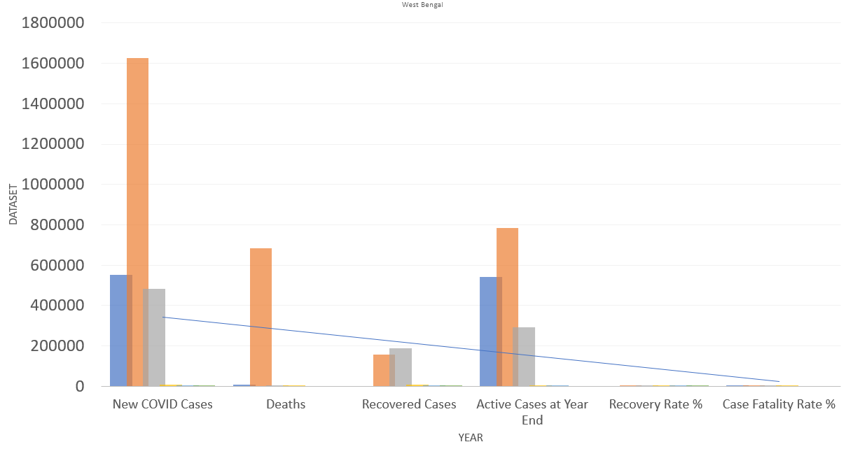
Dataset Description of West Bengal
Year
2020 - 2025
State/UT
West Bengal
New COVID Cases
26,71,381
Deaths
6,94,485
Recovered Cases
3,57,436
Active Cases at Year End
16,19,460
Recovery Rate %
57.16167 %
Case Fatality Rate %
7.373333 %

Slide 7
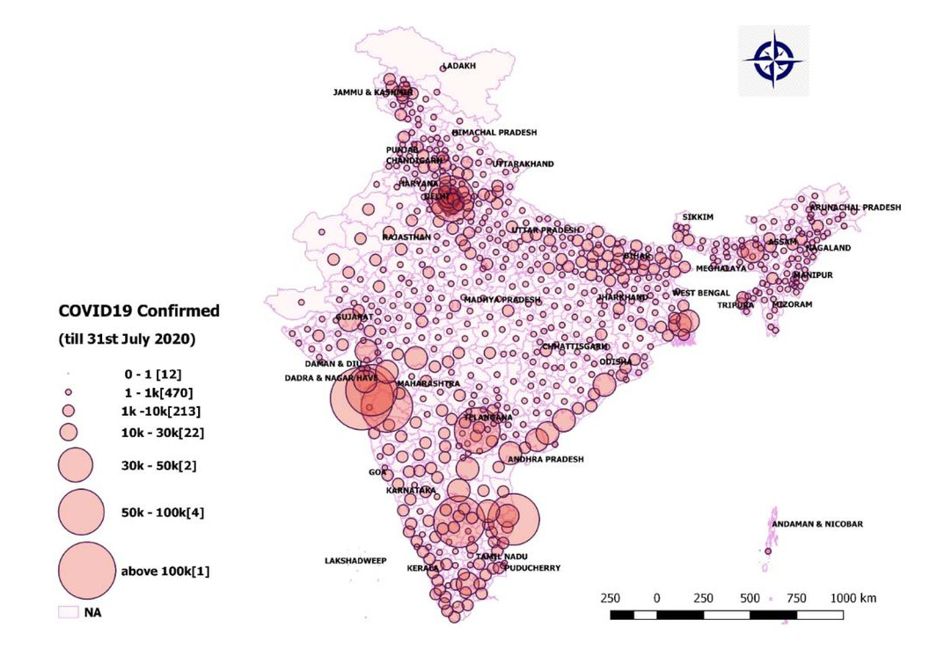
Dataset Description of India
Year
2020 - 2025
Country
India
New COVID Cases
5,47,51,723
Deaths
22,94,108
Recovered Cases
61,96,684
Active Cases at Year End
4,62,60,931
Recovery Rate %
48.6847 %
Case Fatality Rate %
2.5175 %

Slide 8
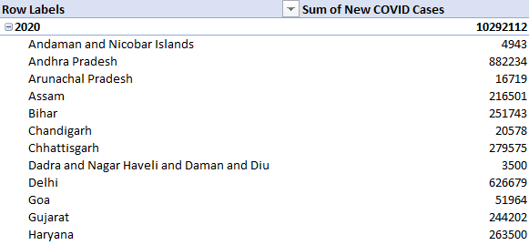
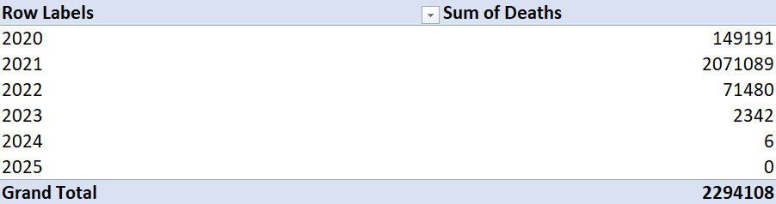
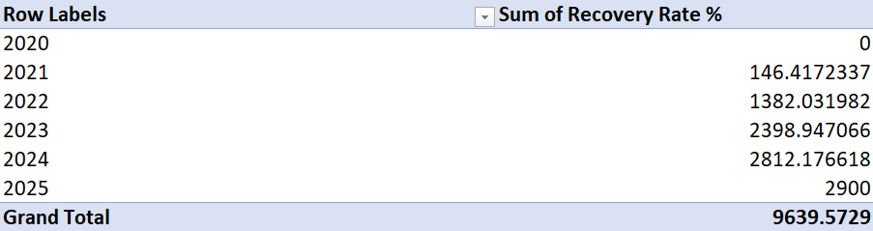
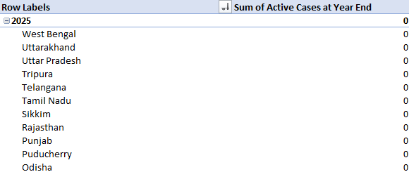
Data Analysis Using PivotTables
State wise analysis of new covid cases
Year wise analysis of total death
Year wise analysis of recovery rate
State wise analysis of active cases

Slide 9
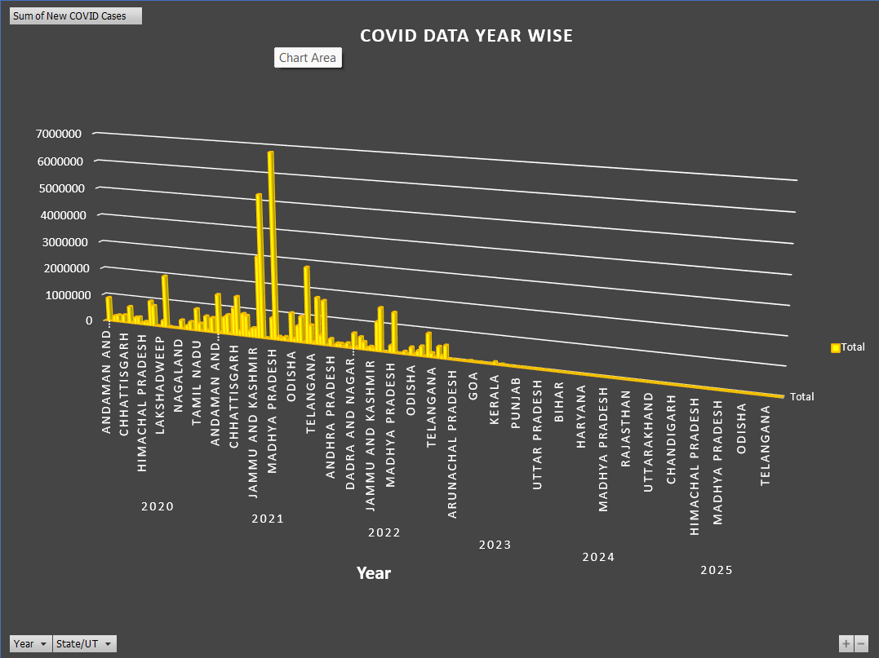
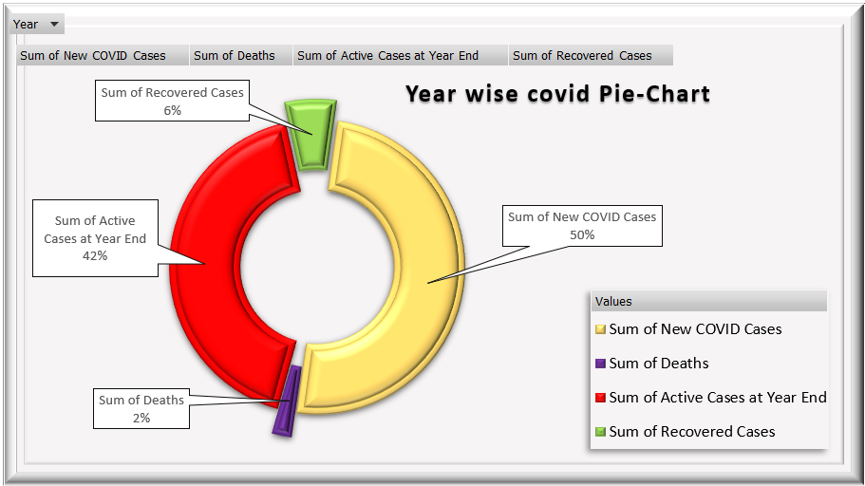
PivotCharts
This chart shows the year-wise distribution of new COVID-19 cases across different States and Union Territories.
The pie chart shows the overall distribution of new cases, active cases, recovered cases, and deaths during the COVID-19 period.

Slide 10
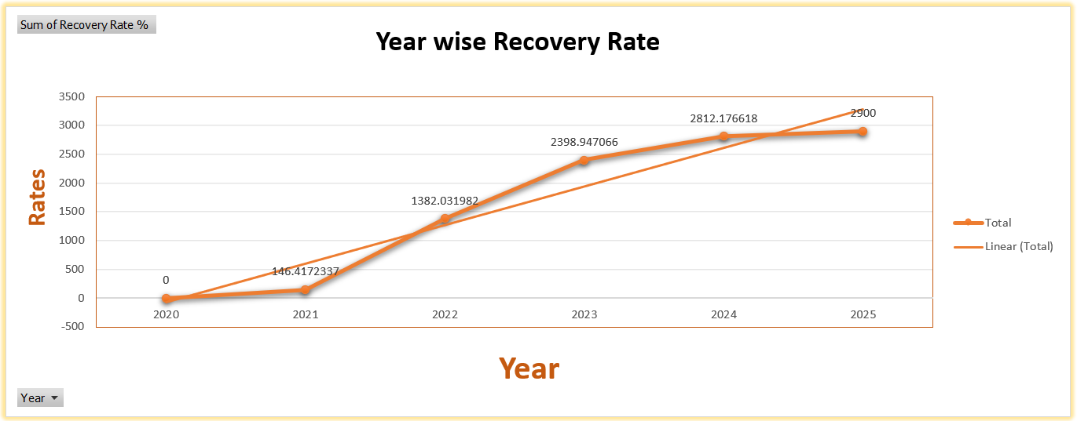
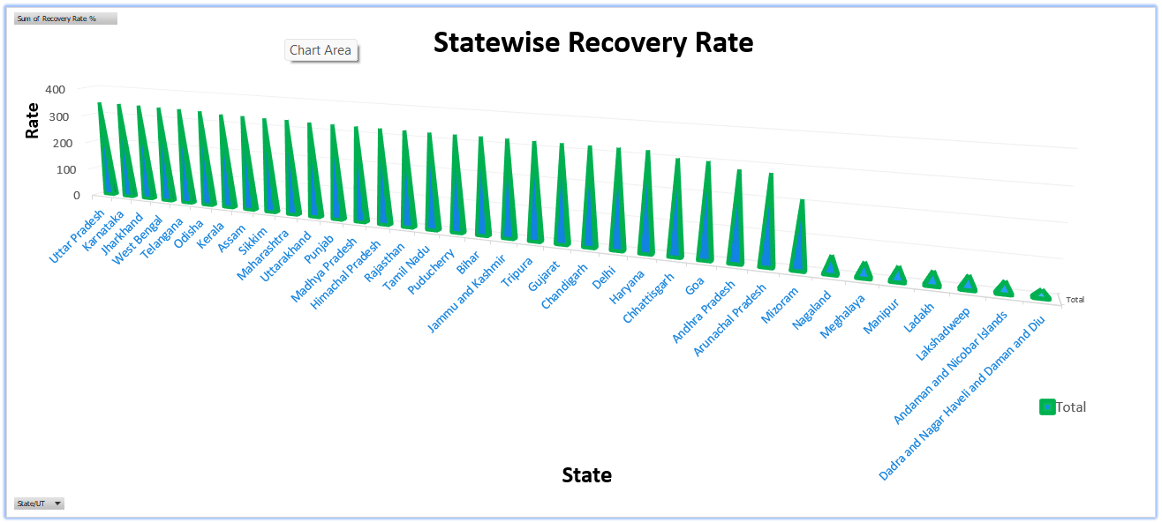
PivotCharts
The chart shows a steady increase in the overall COVID-19 recovery rate from 2020 to 2025.
The chart compares the recovery rates of different States and Union Territories, showing significant variations among them.

Slide 11
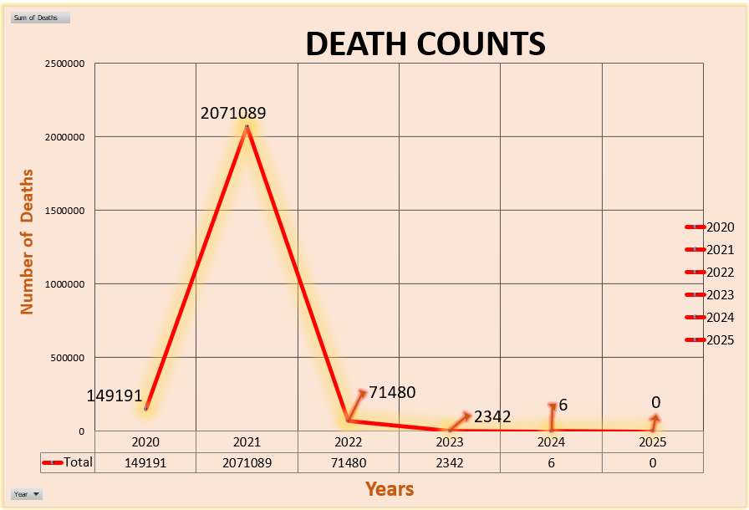
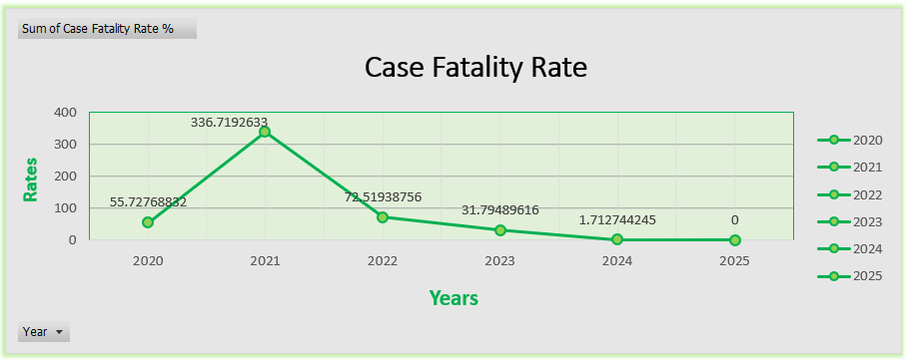
PivotCharts
The chart shows that COVID-19 deaths peaked in 2021 and declined significantly in the following years.
The chart shows a significant decrease in the case fatality rate from 2021 to 2025.

Slide 12
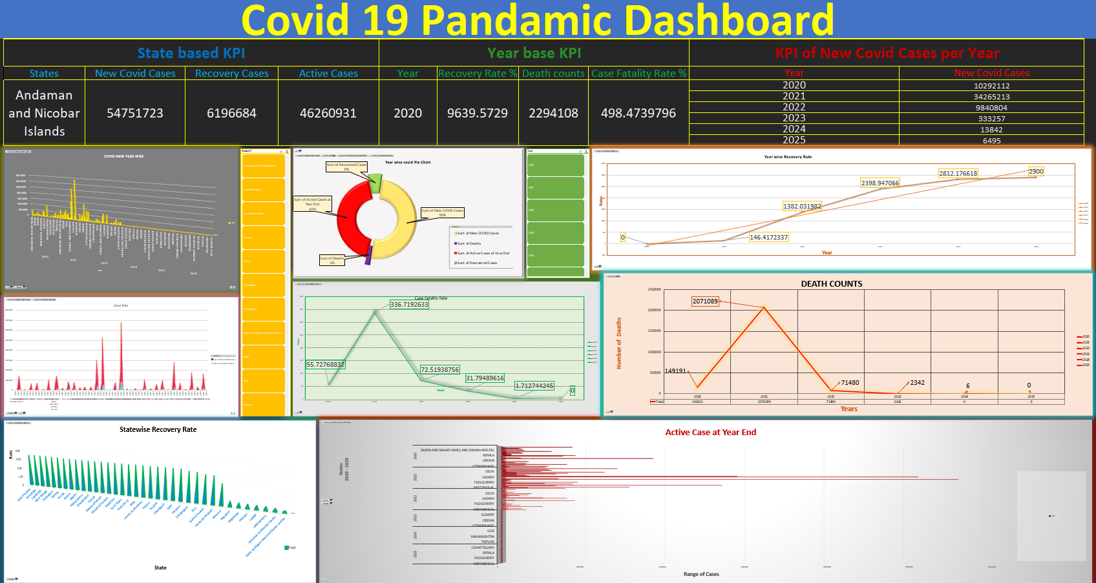
Dashboard
The dashboard provides a visual overview of COVID-19 cases, recoveries, deaths, and rates across different years and States/Union Territories.

Slide 13
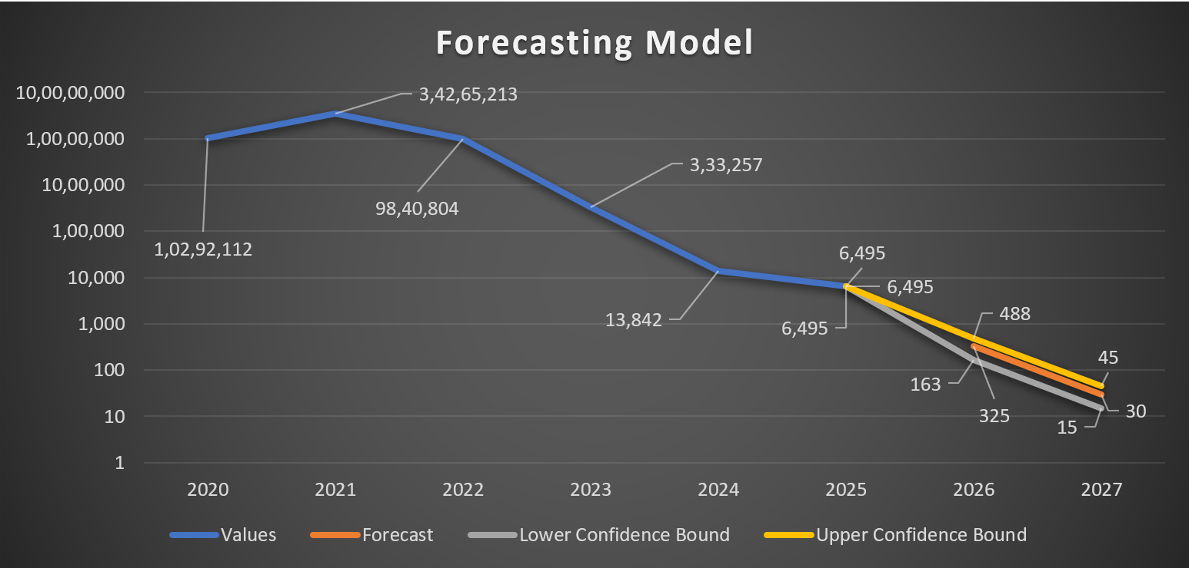
Forcasting Model
The forecasting model predicts a sharp decline in COVID-19 cases from 2025 to 2027, with confidence bounds showing the possible range of future values.

Slide 14

Impact of COVID-19
COVID-19 had a major impact on people and the global economy. Millions of people became infected, and many lost their lives or faced health problems. Lockdowns and restrictions affected businesses, jobs, education, travel, and daily life. Many small businesses suffered financial losses, while unemployment and economic uncertainty increased. The pandemic also highlighted the importance of healthcare, public awareness, and preparedness for future health emergencies.
Precautions to Reduce the Spread of COVID-19
Wear a mask in crowded or high-risk areas
Wash hands regularly with soap or use hand sanitizer
Maintain physical distance when necessary
Avoid close contact with people showing symptoms
Keep indoor spaces well ventilated
Stay home and avoid contact with others

Slide 15

Conclusion
The COVID-19 data analysis provided a clear understanding of the impact of the pandemic across different years and States/Union Territories. Using Excel, the data was analyzed through PivotTables, PivotCharts, and a dashboard to identify important trends in cases, recoveries, and deaths. The forecasting model also shows a significant decline in future cases, highlighting the importance of data analysis in understanding and preparing for health emergencies.
Project by Farhana Sultana, Rabin Das & Sanju Jana - Excel Final Project | COVID-19 / Epidemic Data Analysis & Forecasting Model

